Slide 1
2024
Correlation between National Senior Certificate Subjects , High Certificate Modules and Degree Certificates Modules

Slide 2
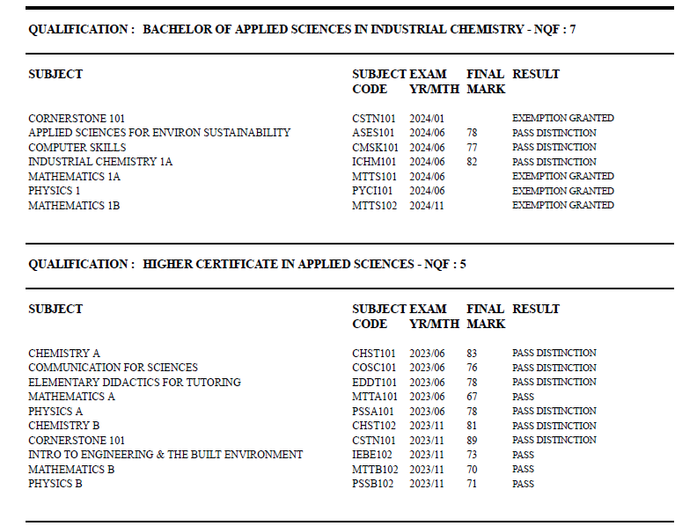
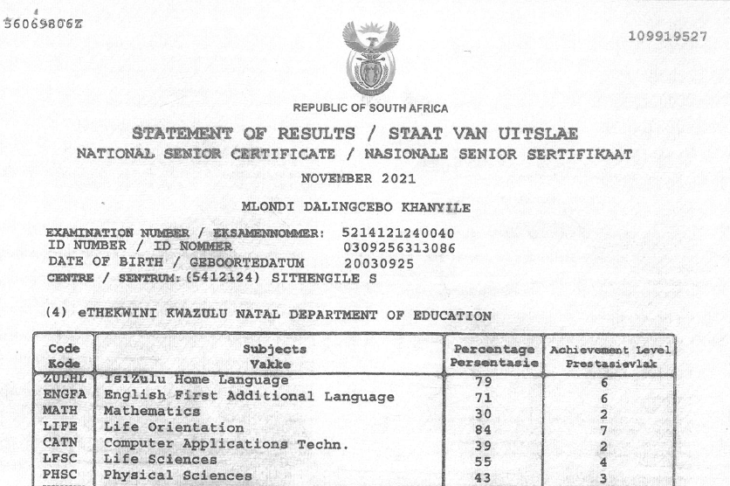
Academic Results for Mlondi Khanyile (22224229)

Slide 3
Higher Certificate in Applied Science - Cum Laude Students
No. | Surname | Name | Student number | Matric Subjects | Percentage Mark | Higher Cert Modules | Final Mark | Undergraduatae Qualification Enrolled in | Fina Mark
 |  |  |  |  |  |  |  | BAppSc Industrial Chemistry Modules
1 | Khanyile | Mlondi Dalingcebo | 22224229 | English First Additional Language | 71 | Chemistry A | 83 | Applied Sciences for Environmental Sustainability | 78
 |  |  |  | IsiZulu Home Language | 79 | Communication for Sciences | 76 | Computer Skills | 77
 |  |  |  | Life Orientation | 84 | Elementary Didactics for Tutoring | 78 | Industrial Chemistry 1A | 82
 |  |  |  | Computer Applications Technology | 39 | Mathematics A | 67
 |  |  |  | Life Sciences | 55 | Physics A | 78
 |  |  |  | Mathematics | 43 | Chemistry B | 81
 |  |  |  | Physical Sciences | 57 | Cornerstone 101 | 89
 |  |  |  |  |  | Intro to Engineering and the Built Environment | 73
 |  |  |  |  |  | Mathematics B | 70
 |  |  |  |  |  | Physics B | 71

Slide 4
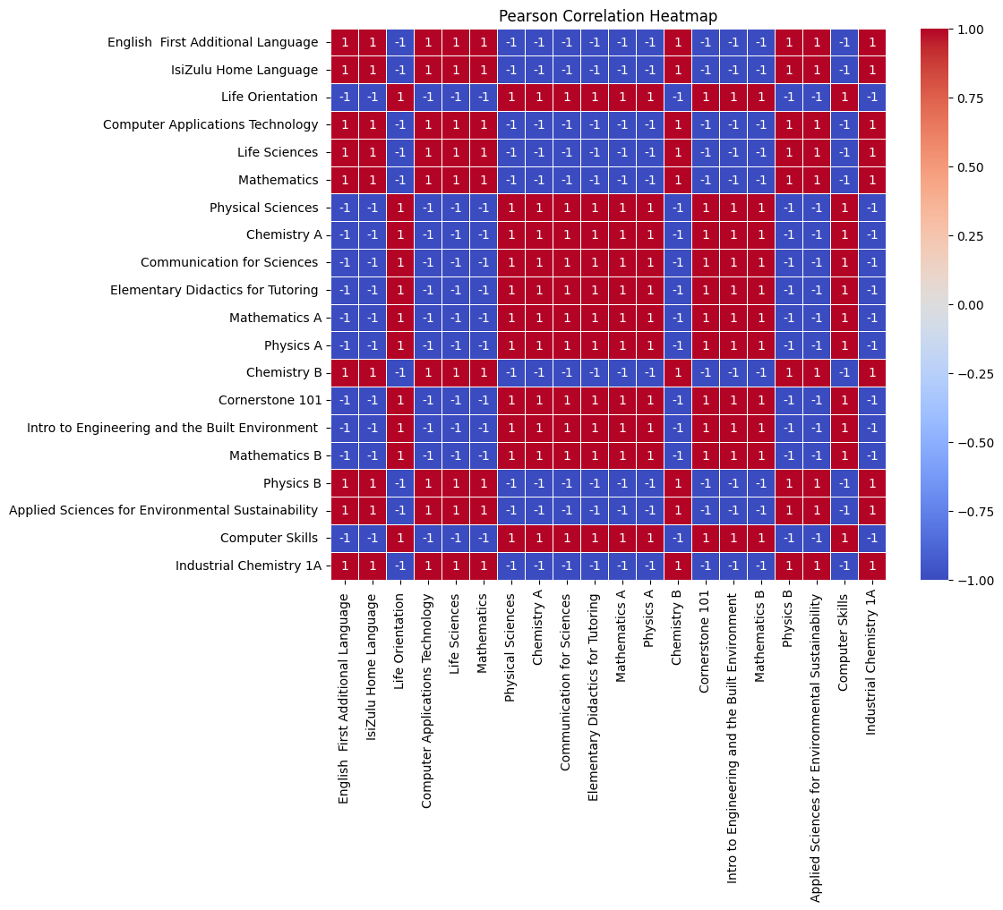

Slide 5
Heatmap Correlation Analysis: Positive Insights and Interpretation
Strong Positive Correlations (Red Cells) within Subject Clusters:
We observe that subjects within similar fields, especially STEM (Science, Technology, Engineering, Mathematics) subjects, tend to have strong positive correlations.
Mathematics A and Mathematics B
Physics A and Physics B
Chemistry A and Chemistry B This indicates that students who perform well in one mathematics or science subject are likely to perform well in other related subjects. Such patterns are expected due to the shared foundational concepts and skills between these subjects.

Slide 6
Heatmap Correlation Analysis: Negative Insights and Interpretation
Strong Negative Correlations (Blue Cells) Between Humanities and STEM:
A prominent pattern is the strong negative correlation between language-oriented subjects like English First Additional Language and IsiZulu Home Language, and most of the STEM subjects such as Mathematics, Physical Sciences, and Chemistry.
This suggests that students performing well in language or humanities subjects tend to struggle with STEM subjects, and vice versa.
This finding highlights the need for differentiated instructional strategies, as students' strengths in language-oriented courses may not translate to STEM courses.

Slide 7
Heatmap Correlation Analysis: Specific Observations Insights and Interpretation
Computer Skills shows moderate negative correlations with almost all subjects, except for a few positive correlations, suggesting that students struggling with other subjects may also struggle with digital literacy.
Applied Sciences for Environmental Sustainability shows mixed correlations. It is positively correlated with environmental and life science subjects but negatively correlated with purely mathematical or chemical subjects. This highlights the interdisciplinary nature of the subject, which appeals to students with specific interests.

Slide 8
Heatmap Correlation Analysis: Inverse Relationships (Negative Correlations) in Mixed Fields Insights and Interpretation
Inverse Relationships (Negative Correlations) in Mixed Fields:
Life Orientation and subjects like Computer Applications Technology have strong negative correlations with technical subjects like Industrial Chemistry 1A and Physics.
This pattern suggests that these courses, often focused on personal development and basic computer skills, do not translate directly into academic success in more technical disciplines.

